Slide 1
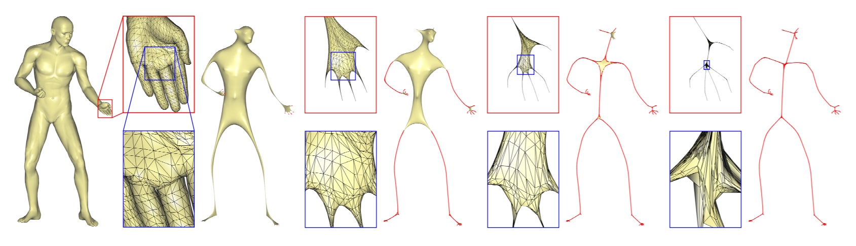
Skeletonization
James Ensminger, Sebastian Heilemann, Austin Steepleton
Austin Steepleton
James Ensminger
Sebastian Heilemann

Slide 2
Motivations
Background: One dimensional curve-skeleton structures represent a simplified version of 3D object geometry and topology
Useful in applications:
Animation
Morphing
Shape registration/retrieval
Most existing methods require a volumetric discrete input but many models are only available as surface representation input
These models need to be converted in order to be skeletonized

Slide 3
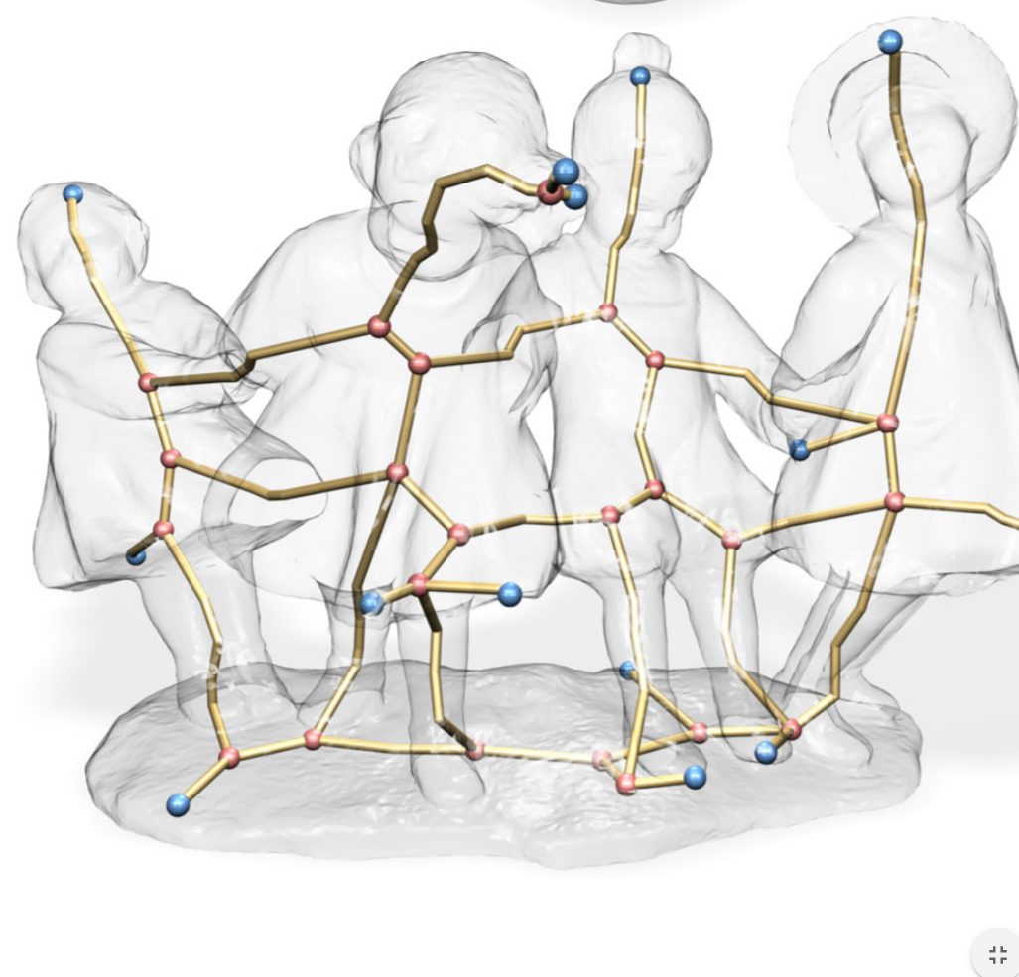
Challenges
The contraction process used to create the skeleton does not necessarily guarantee centeredness within the region
Need to map skeleton mesh during edge collapses and then move skeleton to center
Extracted skeletons have sparser nodes at core
parts of model which could lead to a zig zag
effect
Figure 1
Notes:
The idea is to move each skeleton node k to the approximate center of its corresponding local mesh region Πk . Each boundary of a mesh region comprises a loop of vertices that are contracted to roughly the same location (which is often off center), hence their weighted average displacement represents the shifting of the skeletal node from the center.

Slide 4
Problem Statement
G = (V,E): a mesh with vertices V and edges E
V = [v₁,...,v_{n}]：vertex positions
S = (U,B): a skeleton with nodes U and edges B
U = [u₁,...,u_{n}]: node positions
Given a mesh G, our goal is to use geometric contraction to iteratively smooth the mesh to produce a curve-skeleton S directly from the mesh representation without any voxelization process.

Slide 5
Skeleton Extraction Algorithm
Iteratively smooth and collapse mesh geometry by applying a Laplacian smoothing that moves the vertices along their approximate curvature normal directions | Produces a contracted mesh.
Apply a connectivity surgery to remove all faces from the contracted mesh | Converts contracted mesh into 1D skeleton
Post process geometric embedding | Centers skeleton nodes in their respective regions

Slide 6
Milestone
Mesh Contraction -> April 20th
Primary: Austin Steepleton
Connectivity Surgery -> April 20th
Primary: James Ensminger
Geometric Embedding and GUI Development -> April 27th
Primary: Sebastian Heilemann

Slide 7
Works Cited
O. Au, C-L Tai, H-K Chu, D. Cohen-Or, T-Y Lee, “Skeleton Extraction by Mesh Contraction”, Siggraph 2008

